Slide 1
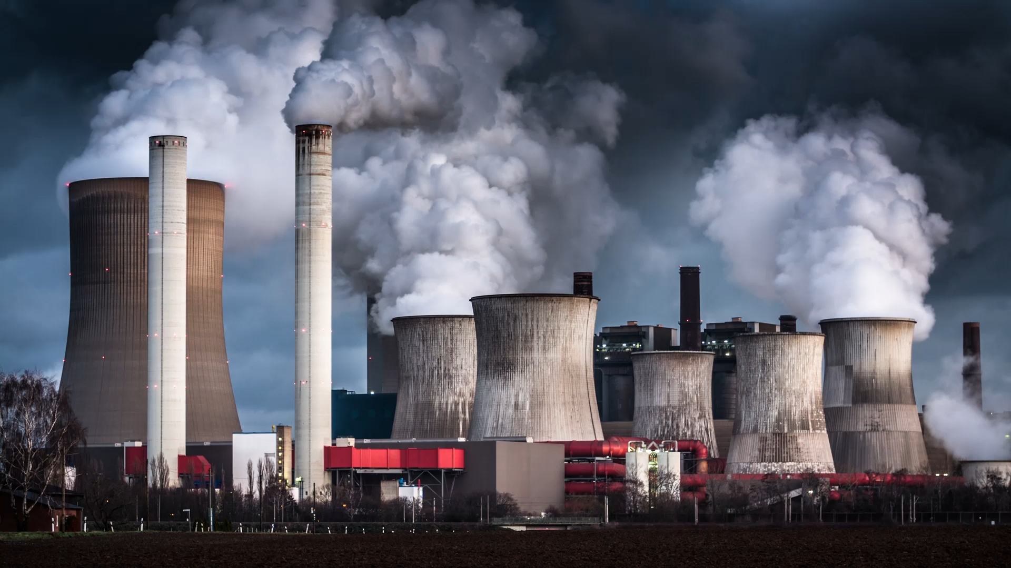
What is fiscal sustainability
Can we service our debt?
How efficiently do we DEAL WITH a shock?
How fair is the burden shared over time?

Slide 2
Why are we doing this?
Both e61 and McKinnon have seen the importance of fiscal sustainability as both an economic issue and as a touch point for public debate.
However, the debate is muddy – unclear definitions of what fiscal sustainability is, why it matters, and what should be done.
McKinnon intends to do its own advocacy work on the issue after building knowledge and capability. E61 work is intended to help with problem definition, and provide an introduction to related concepts.

Slide 3
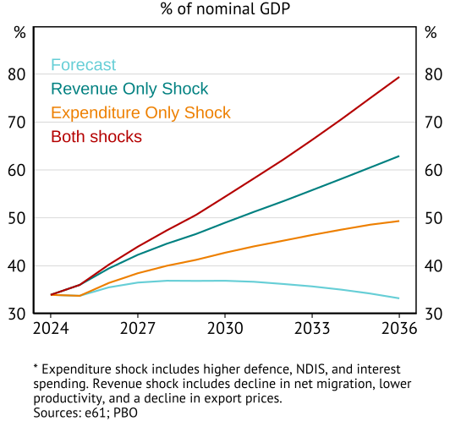
Really bad scenarios
Gross debt at these levels still manageable
But governments will have to respond
Marginal value of public funds
Is our spending going to where it is most valuable?
Do we raise revenue efficiently?
Fiscal sustainability is not about debt spirals.
It is about a tax system and fiscal habits that are designed for a higher growth Australia.
Faced with a shock, the default is to use inefficient transfers (energy subsides) or taxes (bracket creep).
Slower growth should mean fewer transfers from young to old – not more.
Our solution – tax reform.

Slide 4
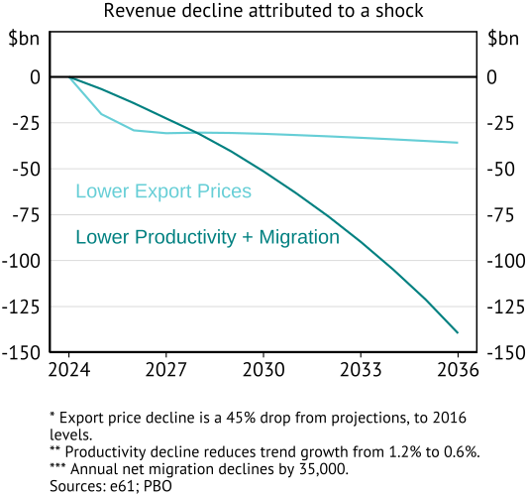
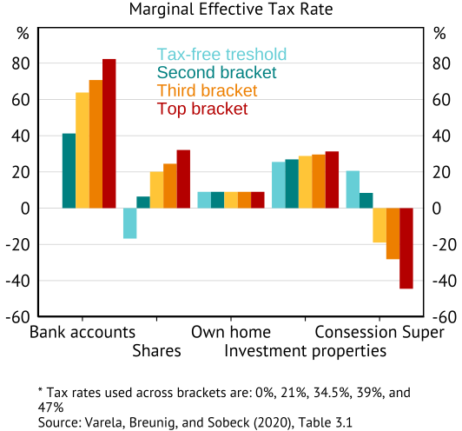
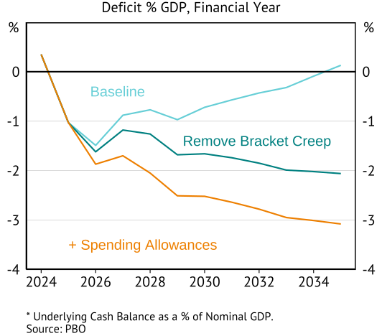
Why make everything about tax?
A lot of the risk is on revenue
There are a lot of gaps in the base
Tax policy gradually rots

Slide 5
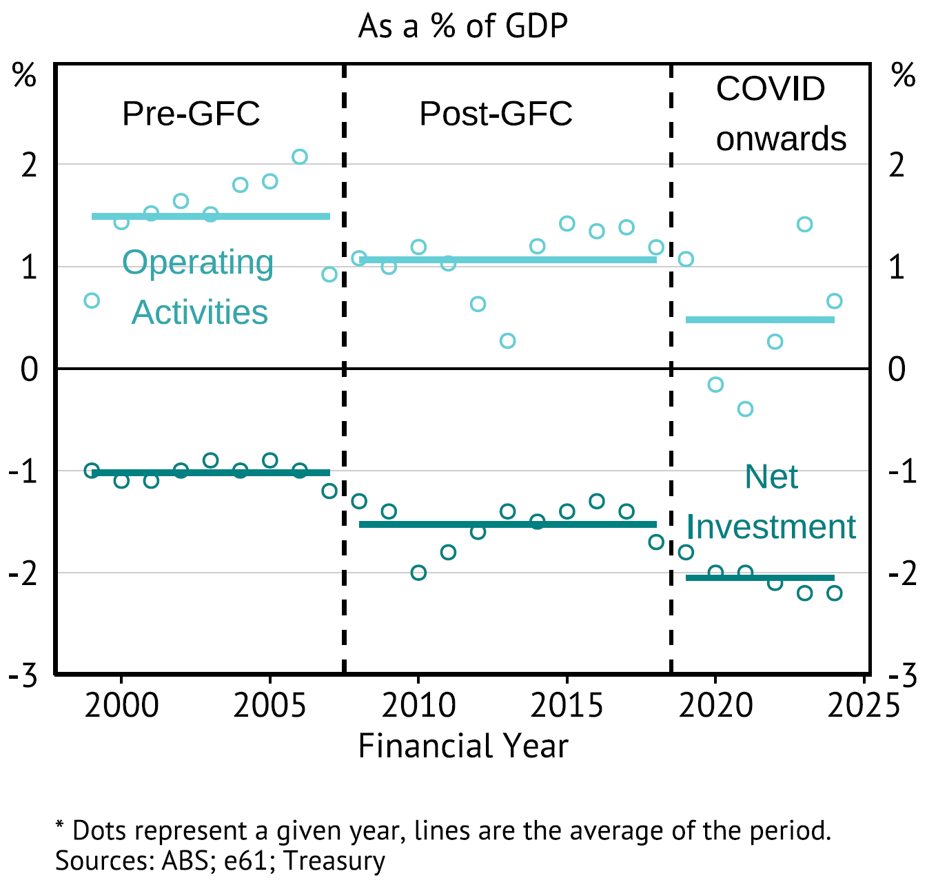
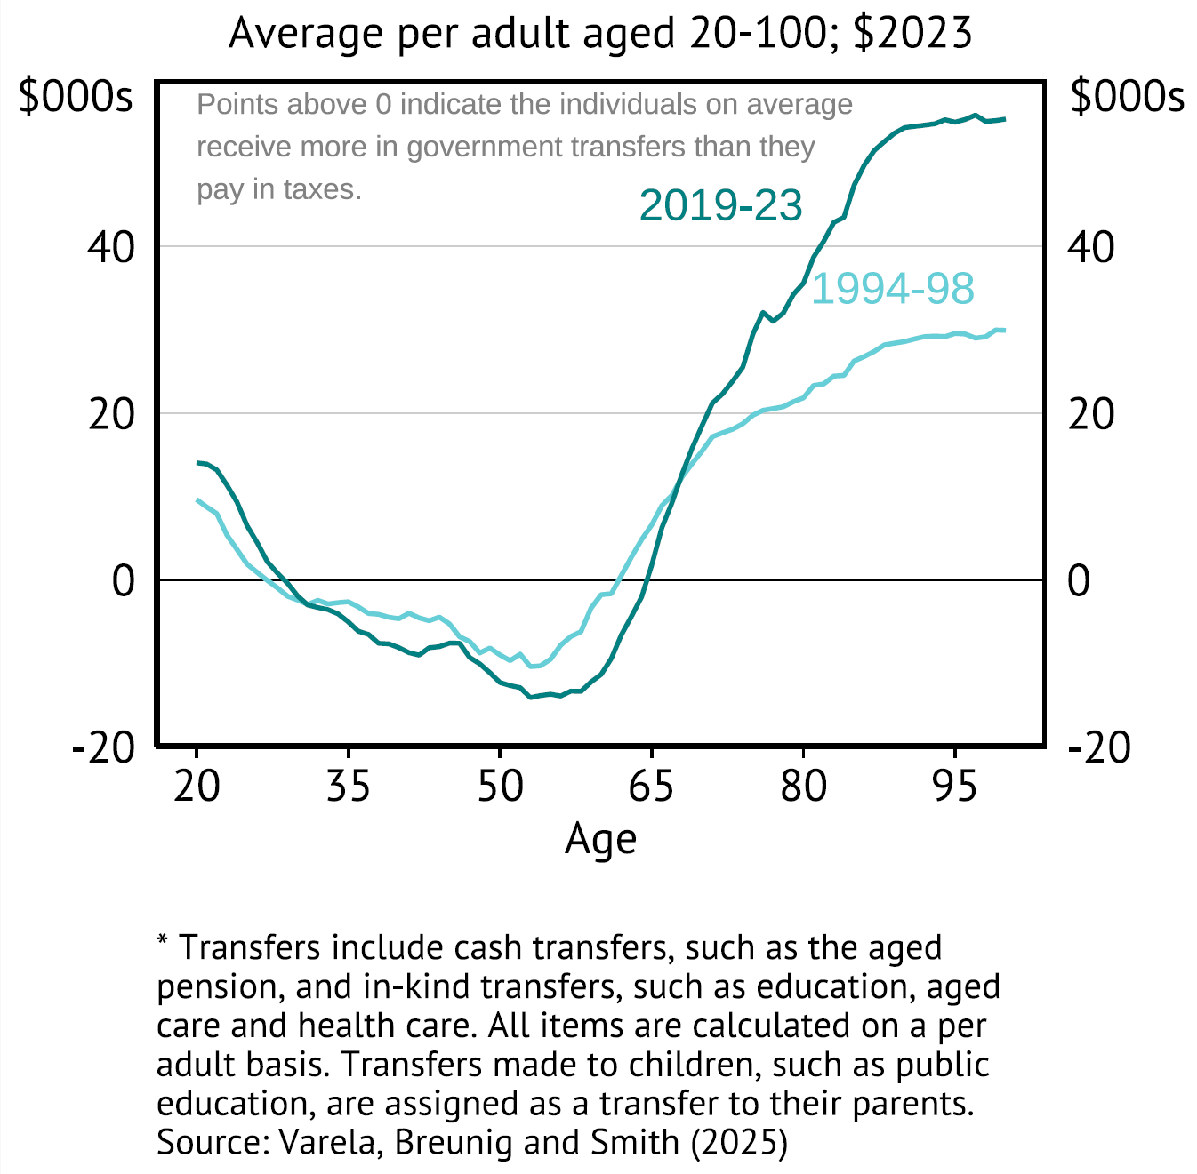
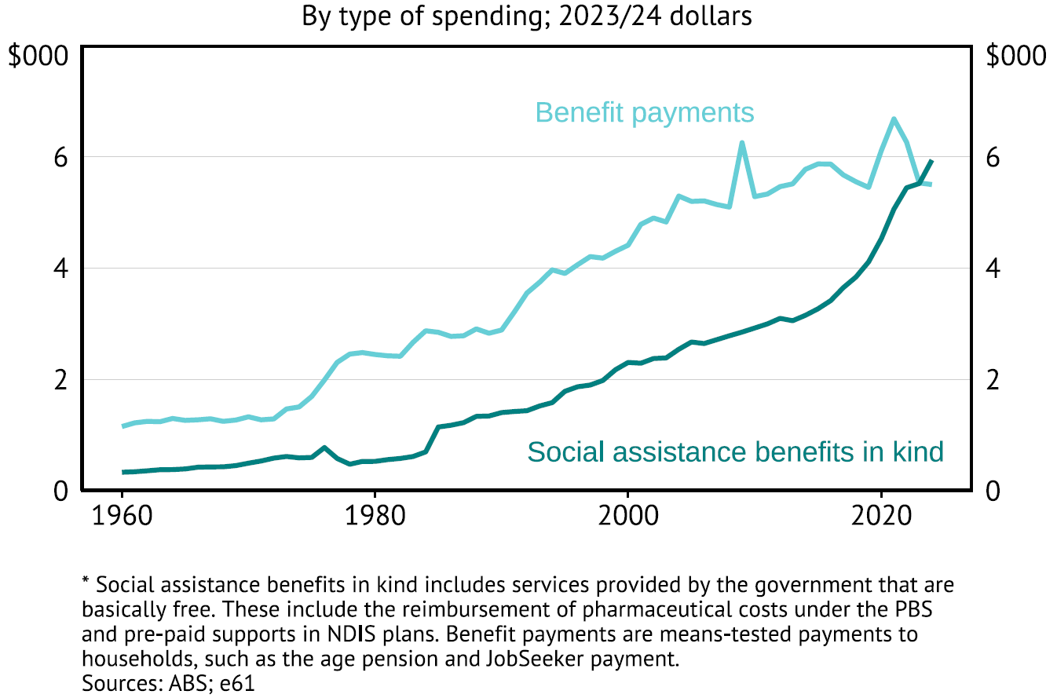
Some non-tax content was allowed
States and consolidated Budgets
Intergenerational equity
Being Sweden
All of this still speaks to … tax reform

Slide 6
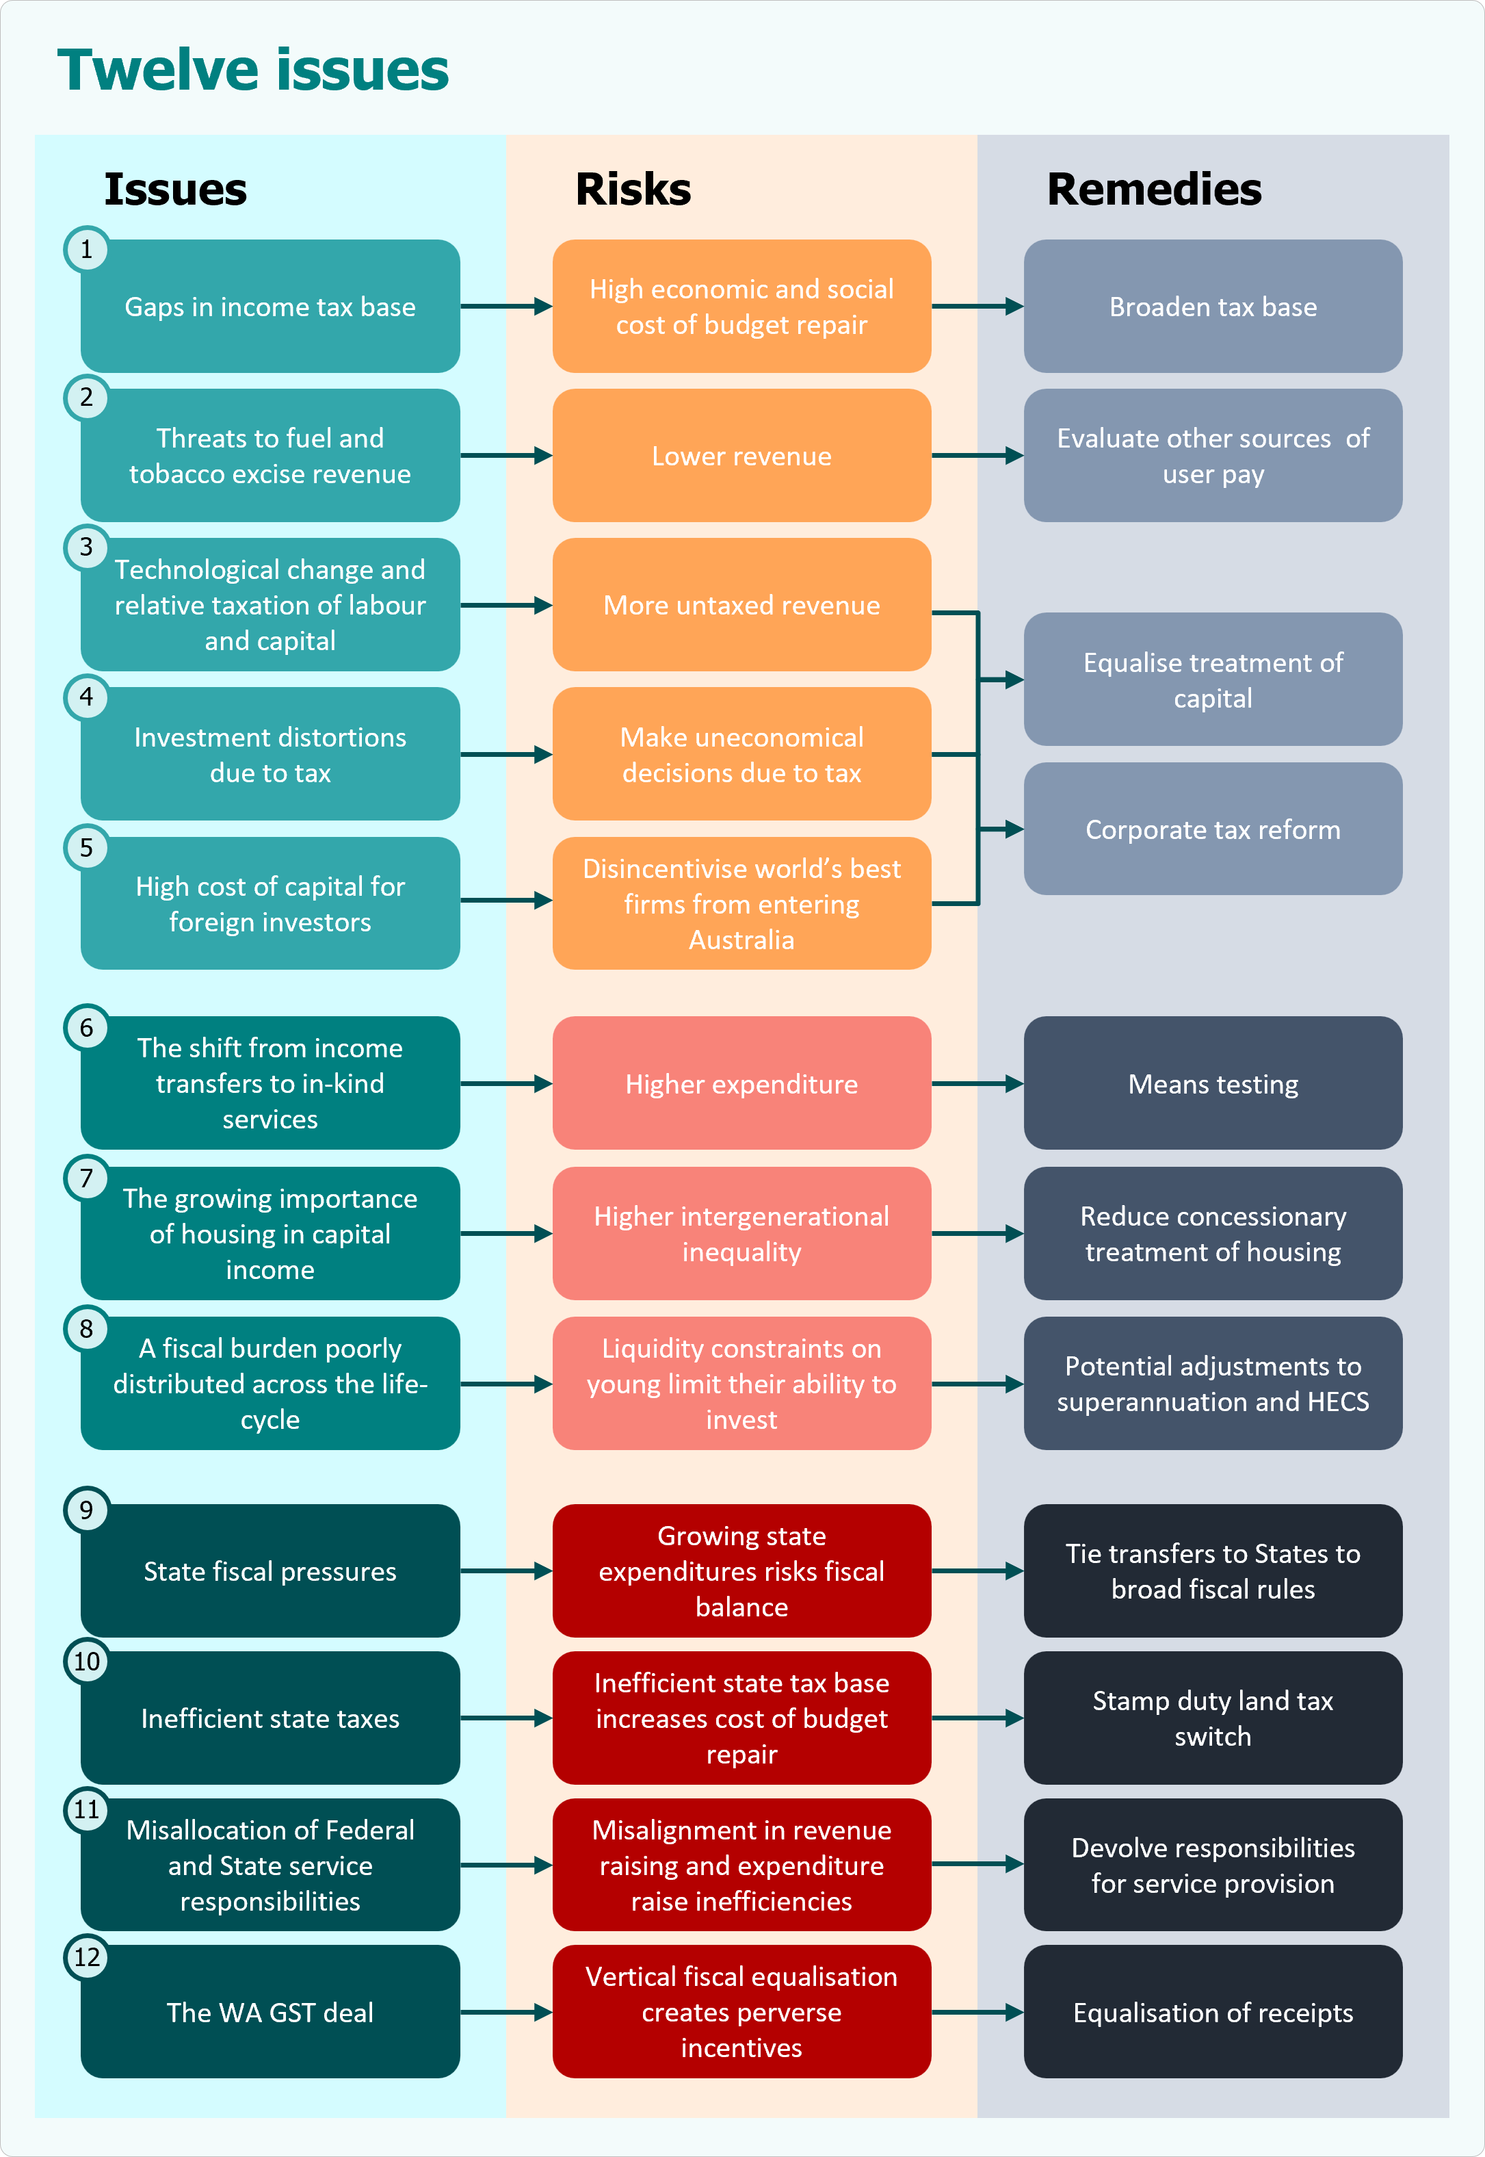
Twelve issues: Specific policies to make this case

